Slide 1

Power Curve Working Group Update
Aarhus, Denmark
8th October 2015

Slide 2
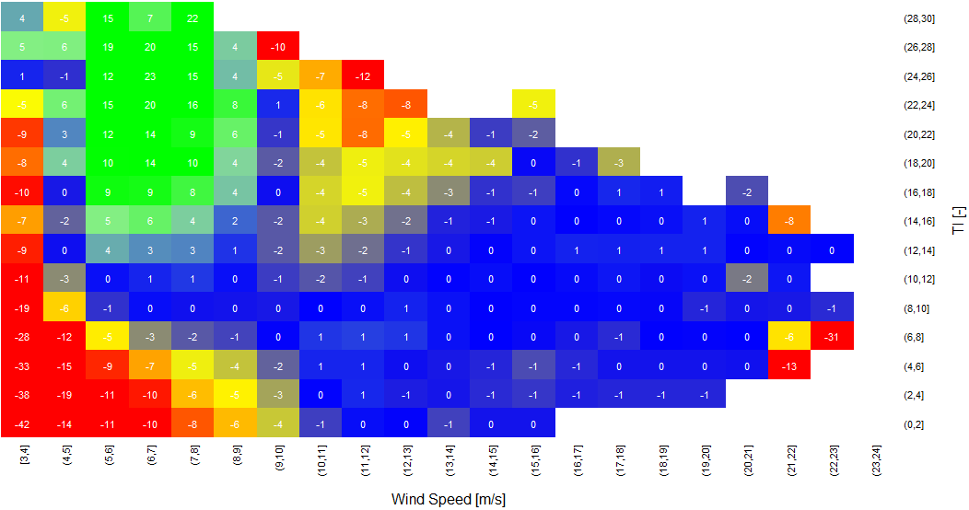
The Power Curve Working Group
The PCWG aims to further refine the accuracy energy yield predictions to improve investor confidence.
The PCWG has over 200 members across 80 organisations.
The PCWG is focused on accurately predicting wind turbine performance in ‘non-standard’ (outer range) atmospheric conditions e.g. low/high shear/veer, low/high turbulence, inflow etc.
Colour = % Power Deviation
Turbulence Intensity [%]
Wind Speed [m/s]

Slide 3
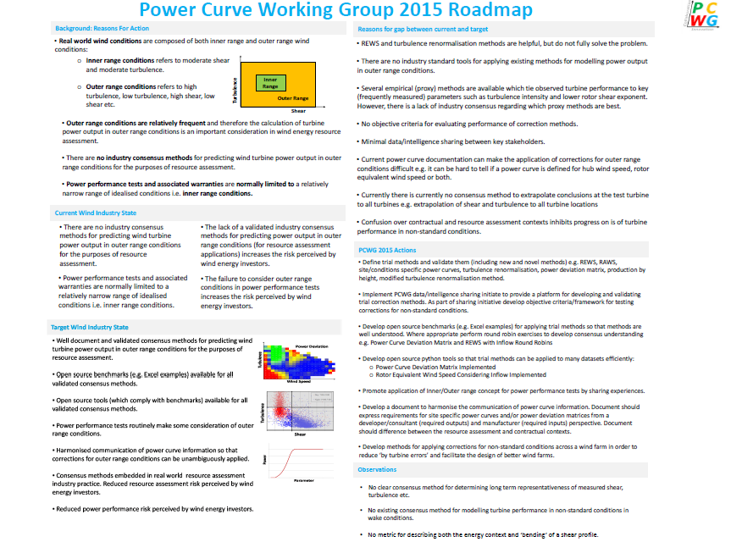
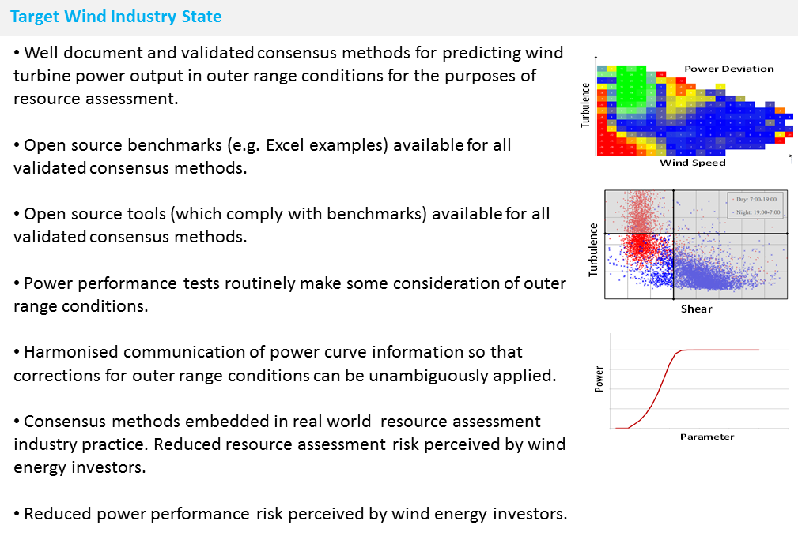
Download PCWG 2015 Roadmap from www.pcwg.org

Slide 4
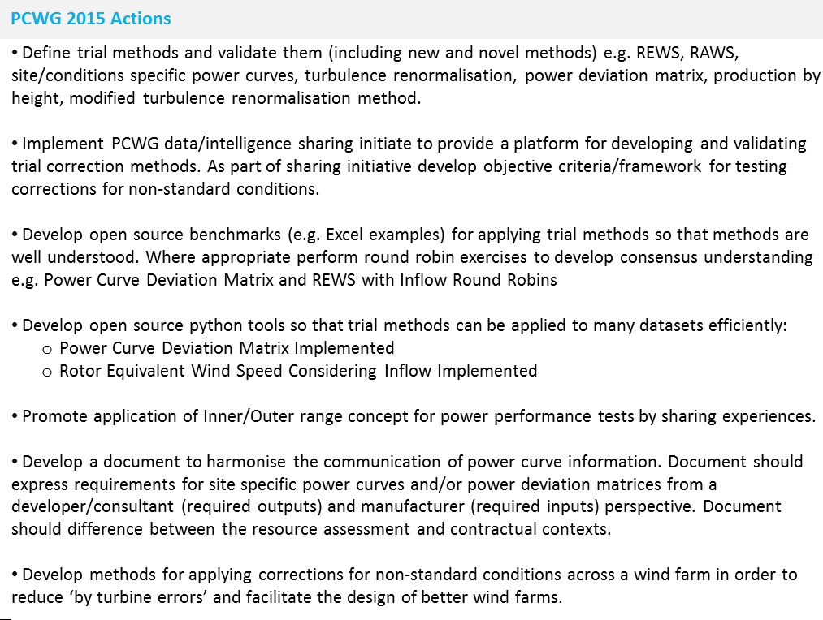
Intelligence Sharing Initiative
Turbine Performance Information Pack
Download PCWG 2015 Roadmap from www.pcwg.org

Slide 5
PCWG-Share-01: Data Flow
Hypothesis/Trial Methodology
Analysis Definition Y
Analysis Definition Y
Analysis Definition Y
Analysis Definition Y
Proprietary Dataset A
Proprietary Dataset B
Proprietary Dataset C
Proprietary Dataset D
Organization A
Organization B
Organization C
Organization D
Hypothesis Performance Metrics
Aggregator
(Academic Institution )
Combination Analysis
How well did the trial method perform?
Aggregated Hypothesis Performance Metrics

Slide 6
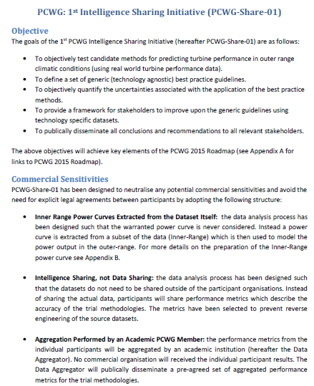
PCWG Intelligence Sharing Initiative
The proposed structure of PCWG-Share-01 has been captured in a “definition document” which has now been finalised and circulated to PCWG members.
Final definition document is available at www.pcwg.org.

Slide 7
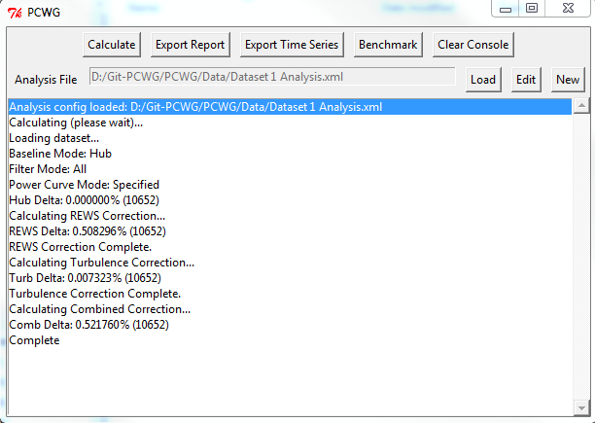
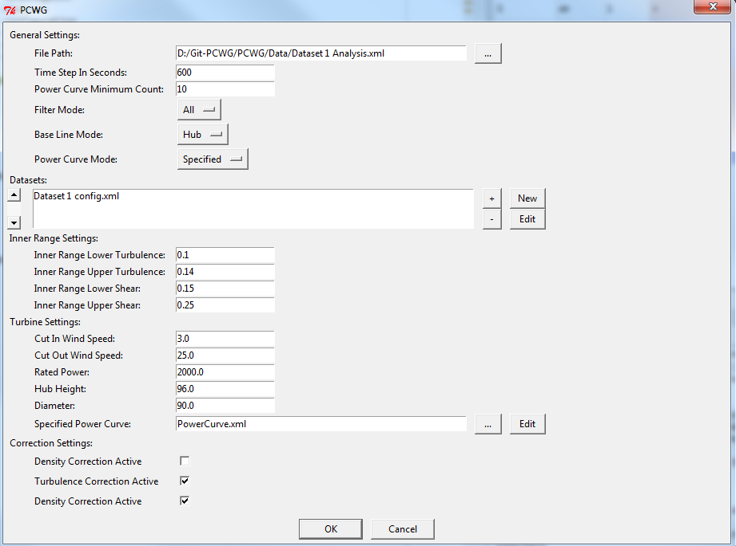
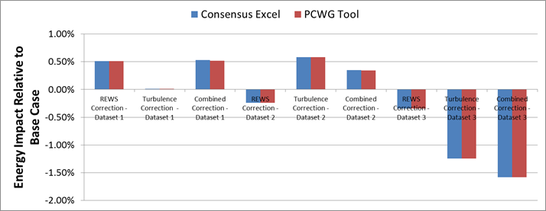
PCWG Analysis Tool
Excel Benchmark and PCWG Analysis Tool Comparison

Slide 8
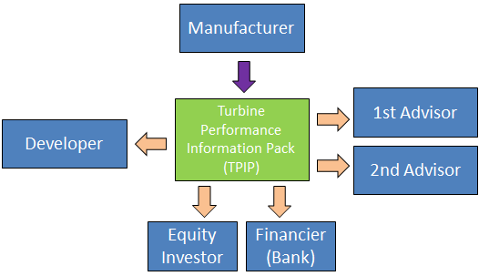
Harmonisation of Power Curve Communication
Another key action of the PCWG 2015 roadmap is the creation of a document to harmonise the communication of power curve information.
The guidelines aim to ensure that all stakeholders can confidently:
Understand the evidence base behind the documented turbine performance.
Understand what elements of the turbine performance data are warranted and what elements are purely informative.
Understand how to model turbine performance in Inner Range Conditions.
Understand how to model turbine performance in Outer Range Conditions.

Slide 9
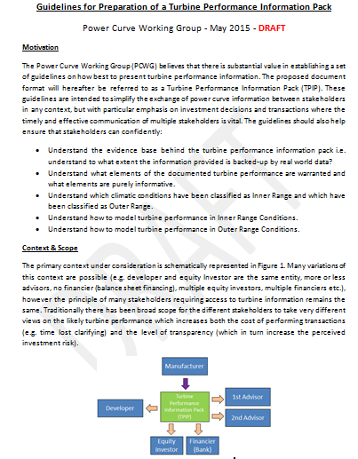
Harmonisation of Power Curve Communication
A DRAFT document “Guidelines for Preparation of a Turbine Performance Information Pack” has been circulated to members and will be discussed at the September and October PCWG meetings.
The current draft is available on DropBox: ‘DRAFT Guidelines for Preparation of a Turbine Performance Information Pack.docx’

Slide 10
September US Meeting Summary
Discussion of PCWG-Share-01:
Board support from US Members
Feedback given on definition document (to be discussed in detail today).
A commitment to participate with 40 datasets from one US member
Presentations on candidate methods for PCWG-Share-02 (to be reviewed today):
Production by Height
Machine Learning
3D Power Deviation Matrix
Discussion on DRAFT Turbine Performance Information Pack Guidelines Document (harmonisation of communication action from roadmap):
Board support from US Members
Several items of feedback (see September minutes)

Slide 11
Review Agenda

Slide 12
Objectives for 8th October 2015
Identify and eliminate any final obstructions to the completion of PCWG-Share-01.
Review Candidate Methods for PCWG-Share-02
Discuss DRAFT Turbine Performance Information Pack Guidelines Document (harmonisation of communication action from roadmap).
Discuss possible 2016 PCWG Road Map
Any other objectives for today?

